Slide 1
LOAN STATUS PREDICTION USING LINEAR REGRESSION
BY
VIGNESH B
SELVAGANAPATHY R

Slide 2
Hello!
We are here to give presentations about loan status prediction.

Slide 3
ABSTRACT
In our banking system, main source of income of any banks is on its credit line.
A bank's profit or a loss depends to a loans whether the customers are paying back the loan or defaulting.
Linear regression models have been performed and the different measures of performances are computed. The models are compared on the basis of the performance measures such as sensitivity and specificity.
Model includes variables (personal attributes of customer like age, purpose, credit history, credit amount, credit duration, etc.) other than checking account information that should be taken into account to calculate the probability of default on loan correctly.
Therefore, by using a Linear regression approach, the right customers to be targeted for granting loan can be easily detected by evaluate.

Slide 4
1.INTRODUCTION
•With the help of machine learning and Linear regression algorithm ,this application is build to choose the perfect candidate who eligible to acquire the loan.
•With the help of this application we can predict the loan status and if the candidate would be able to pay the loan in the time.
•To predict the out come I have used Data set consisting some real time values of accounts holders who are paying loans.

Slide 5
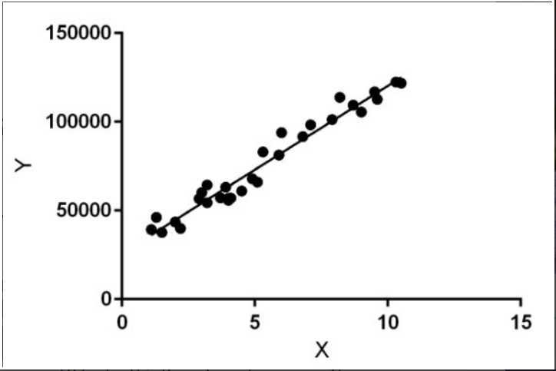
ALGORITHM
LINEAR REGRESSION
Linear Regression is a machine learning algorithm based on supervised learning.
Regression models a target prediction value based on independent variables. It is mostly used for finding out the relationship between variables and forecasting.
Linear regression performs the task to predict a dependent variable value (y) based on a given independent variable (x). So, this regression technique finds out a linear relationship between x (input) and y(output). Hence, the name is Linear Regression.

Slide 6
Purpose
employs a set of pre-classified examples to develop a model that can classify the population of records at large.
Fraud detection and credit risk applications are particularly well suited to classification technique.

Slide 7
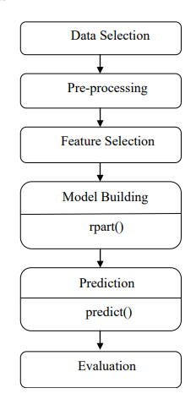
FLOW CHART

Slide 8
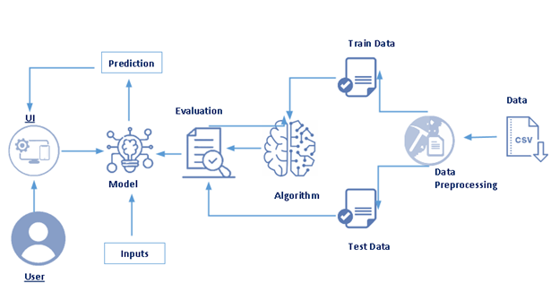
BLOCK DIAGRAM

Slide 9
ADVANTAGES AND DIS-ADVANTAGES
ADVANTAGES:
One of the main advantage is that the prediction is going to be done by the help of machine learning and that will give you the most accurate outcome.
It also reduces the man force for performing experiments to find the solutions to the problems.
It is also budget friendly as it is less expensive.
DIS-ADVANTAGES:
There is possibility that the outcome will not be predicted in the right way and it would not be exactly approximate and that could be troublesome.

Slide 10
CONCLUSION
In this study, a model of prediction is use with the use of algorithms of logistic regressions. More than 600 sample data were collected to use and the tested to build the model of logistic classifier to predict the status of the loan.
The maximum accuracy this model can achieve is more than 90%.
And this accuracy is achieved with the help of the model of regression.

Slide 11
Thank You!

